Slide 1



Objective
sensory data can capture precise movement patterns unique to each exercise, enabling accurate classification. This data enhances real-time feedback, reduces observational errors, and provides insights to improve technique and prevent injuries, supporting applications like fitness tracking and physical therapy.

Slide 2
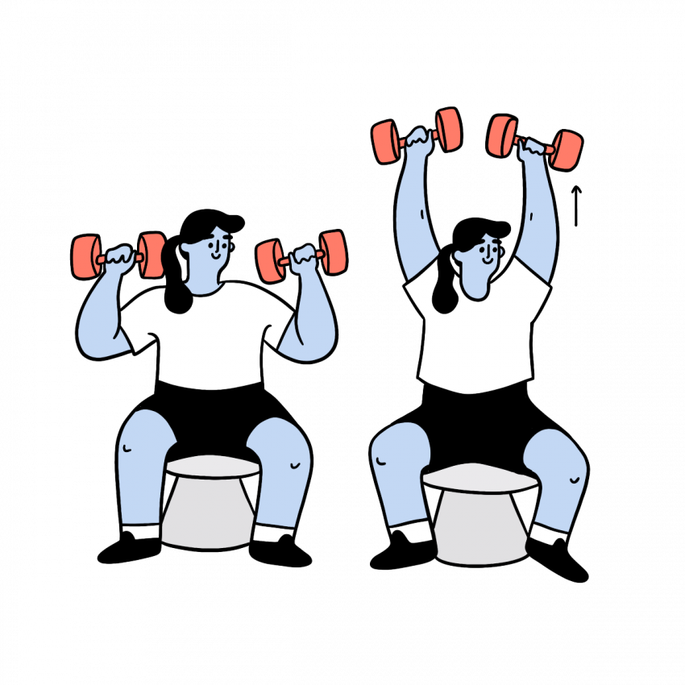
Over Head Press
The overhead press is a shoulder-focused exercise where you lift a barbell or dumbbells from shoulder height to overhead, engaging the shoulders, triceps, and core. It builds upper body strength and stability.

Slide 3
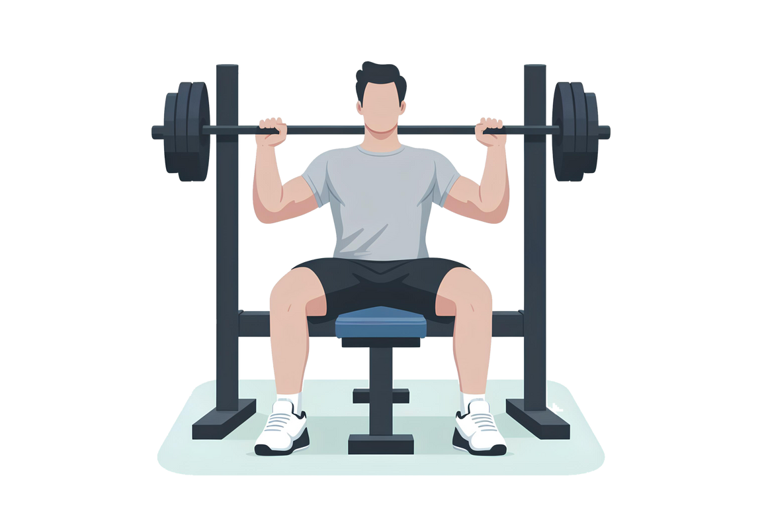
Bench Press
The overhead bench press is a strength exercise targeting the shoulders, triceps, and upper chest. It involves pressing weights above the head from a seated or standing position, enhancing upper body stability and muscle endurance.

Slide 4
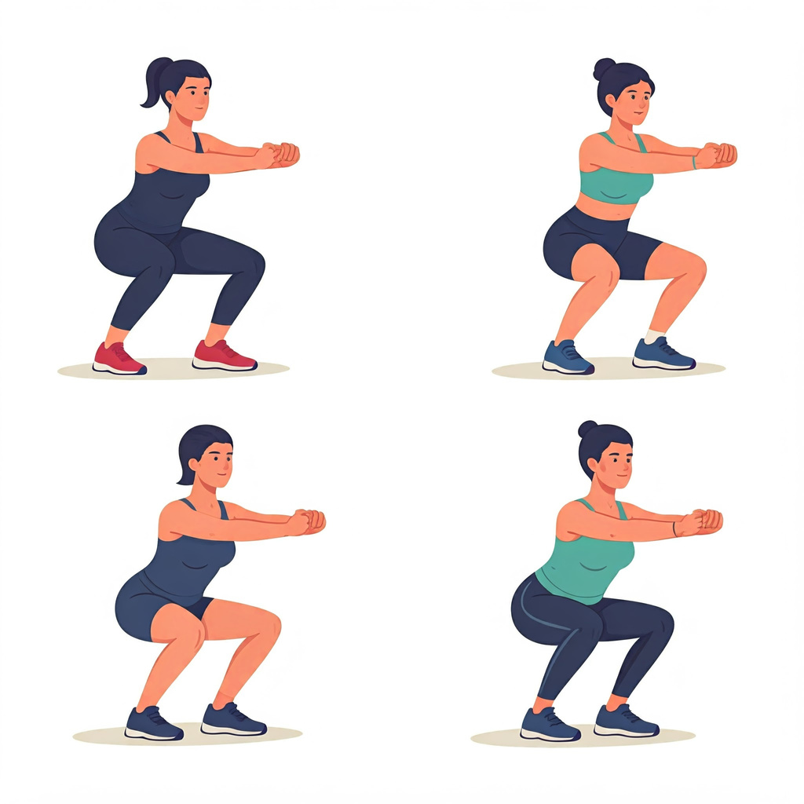
Squat
The squat is a foundational strength exercise targeting the lower body, especially the quadriceps, hamstrings, and glutes. By bending the knees and hips with a straight back, it builds power, improves balance, and enhances mobility.

Slide 5
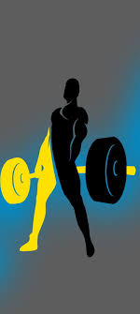
DeadLift
The deadlift is a strength-training exercise where you lift a weighted barbell or dumbbell from the ground to hip level, engaging multiple muscle groups, especially the back, glutes, and hamstrings. It builds power and improves posture when performed with proper form.

Slide 6
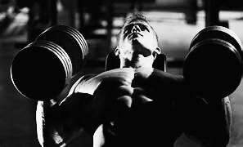
Row
The Row exercise in the gym targets your upper back, shoulders, and arms. It involves pulling weight toward your torso, often using a barbell, dumbbells, or a cable machine, and helps improve posture and build back strength.

Slide 7
Feature Engeneering
Feature Construction
Feature Transformation
Feature Extraction
Feature Selection

Slide 8
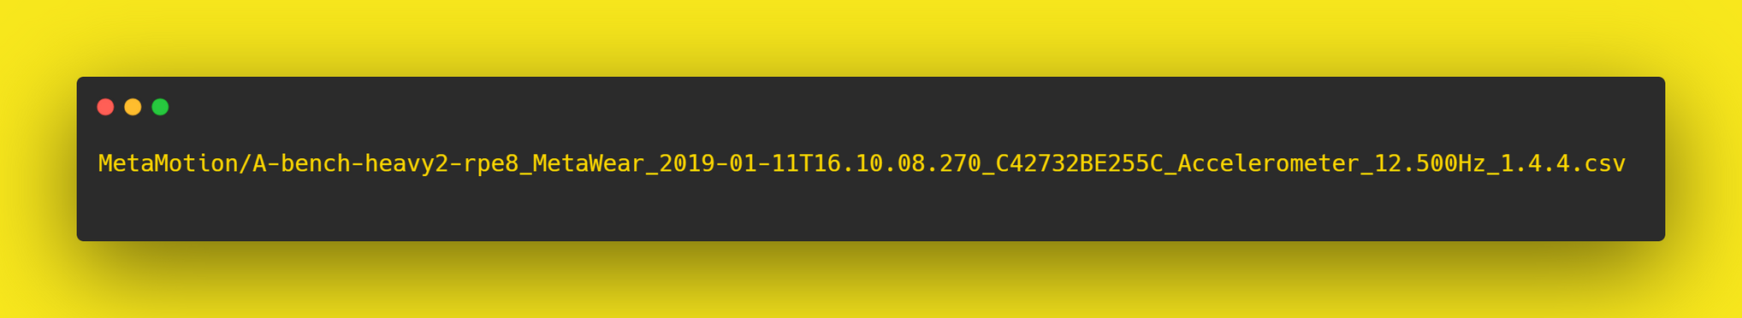
Split
R Strip
concat
Resample(200ms)

Slide 9
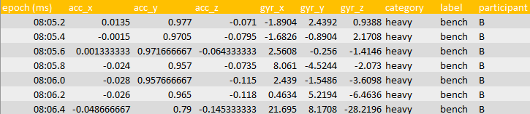
Post Resampling

Slide 10
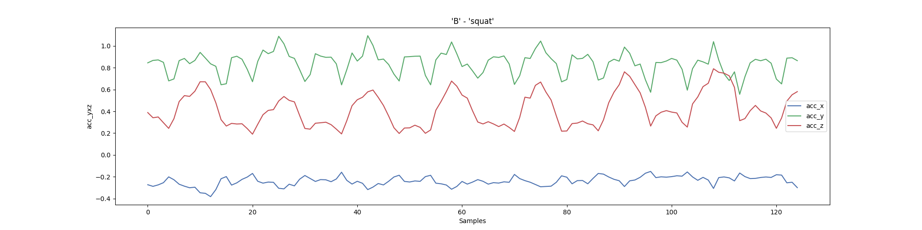
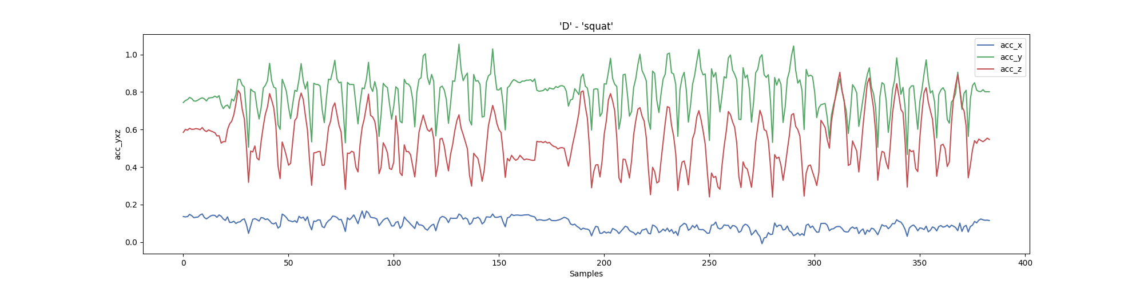

Slide 11
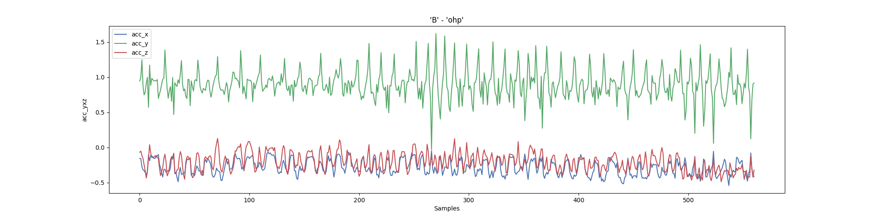
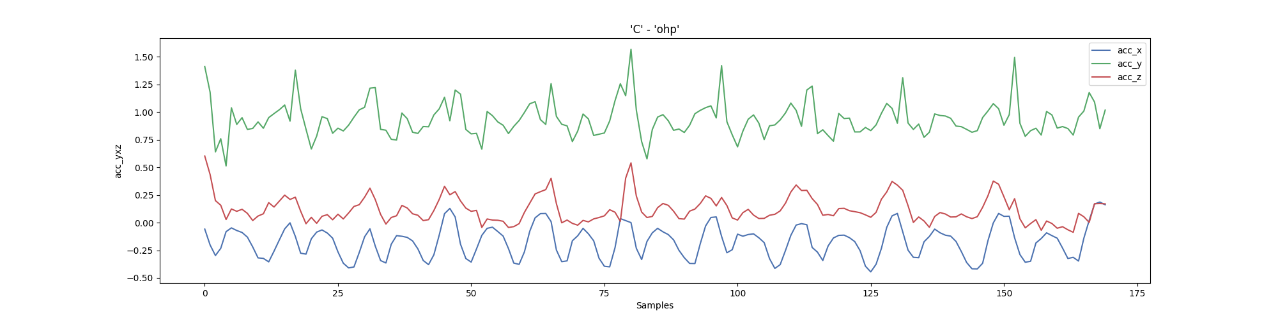

Slide 12
Outliers
Inter Quartile Range
Chauvenet Criteria
Local outlier Factor

Slide 13
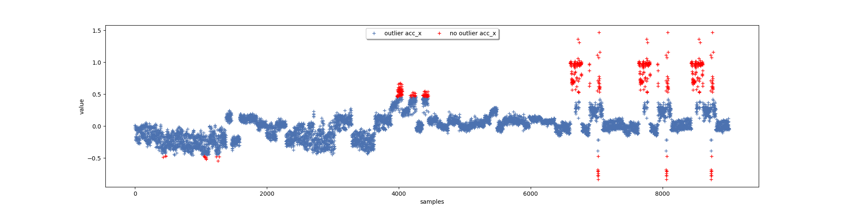
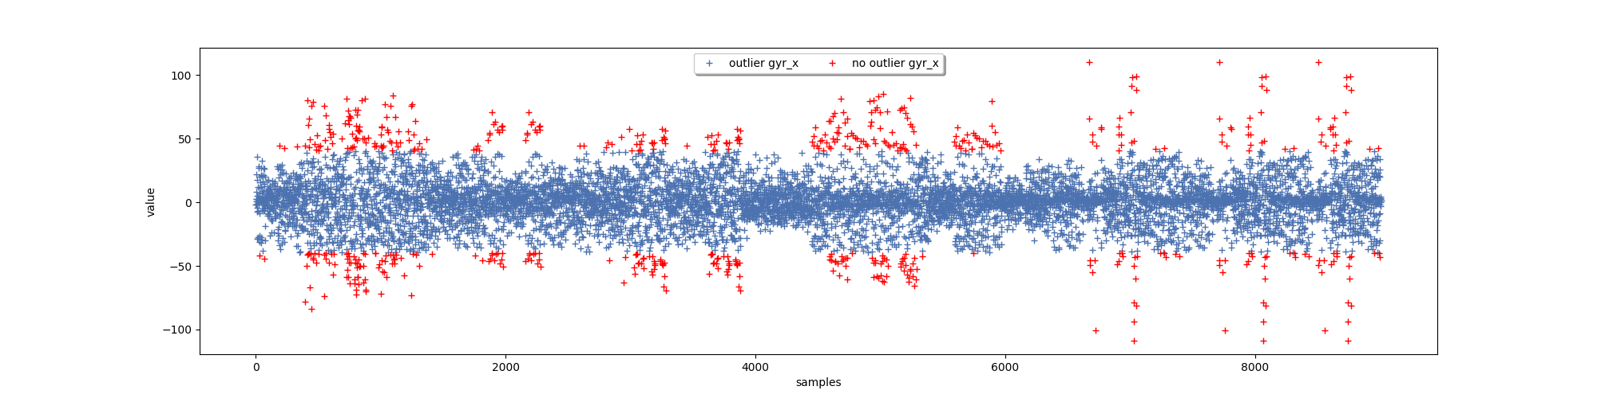

Slide 14
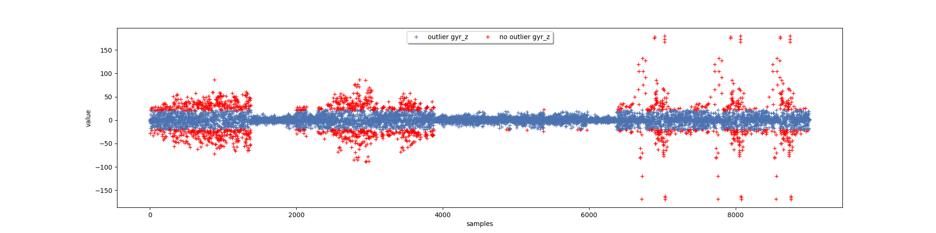

Slide 15
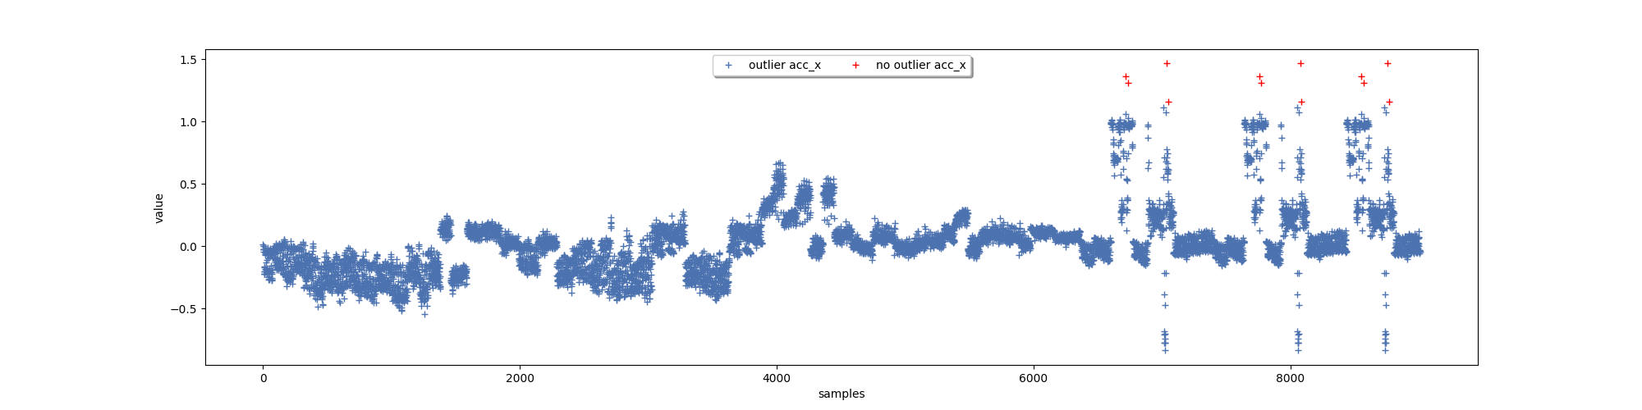
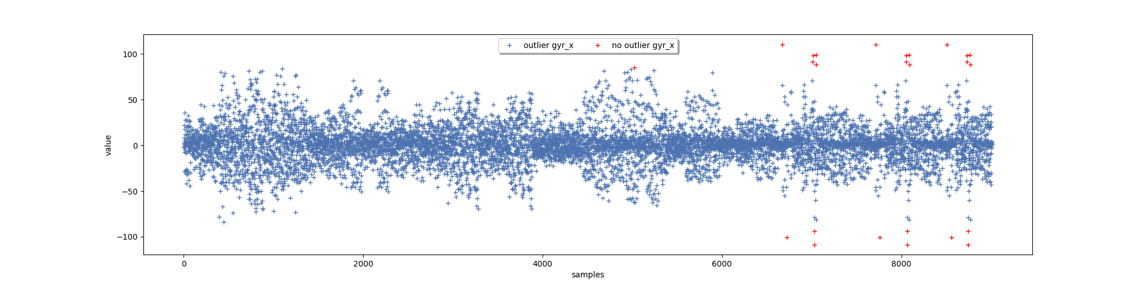

Slide 16
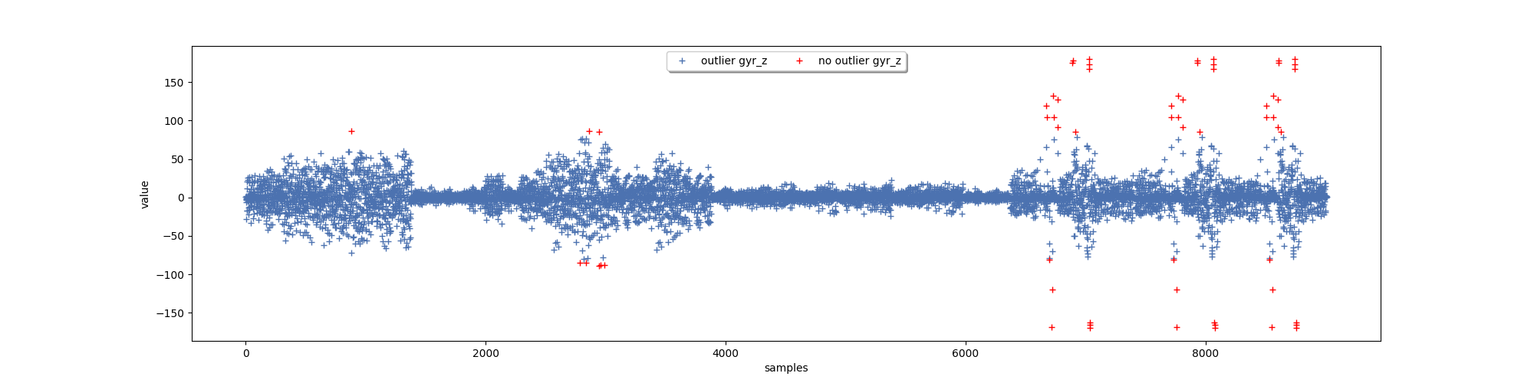

Slide 17
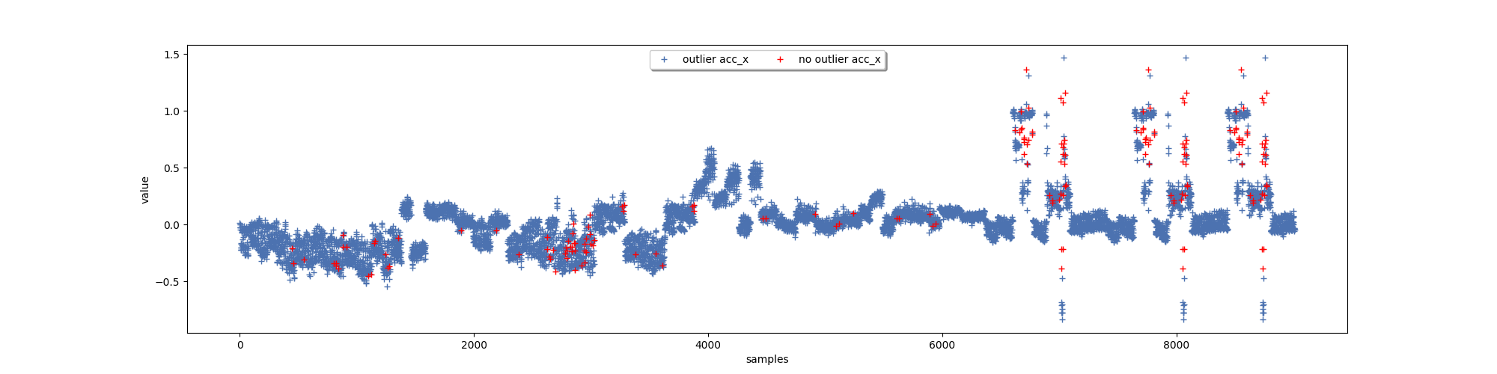
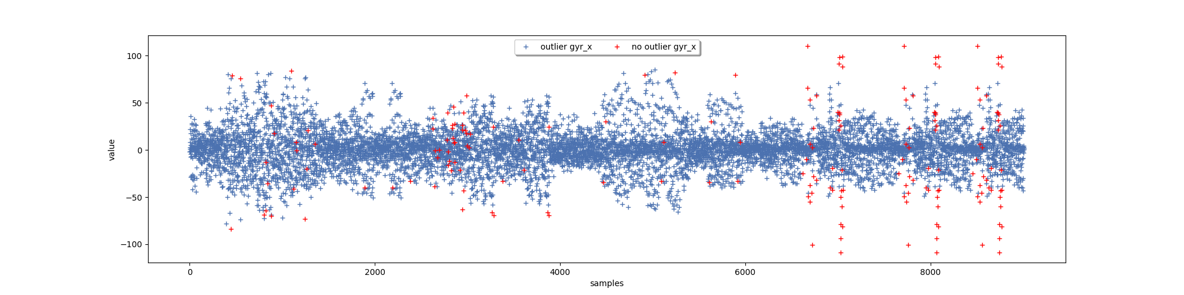

Slide 18
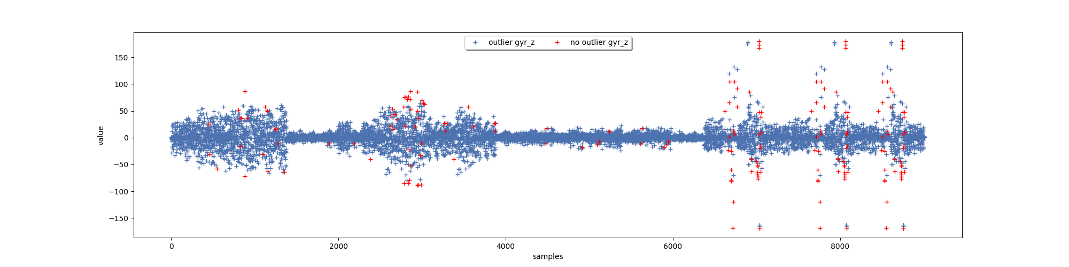
Interpolation with Linear

Slide 19

Principal Component Analysis
3 principal components to
extract as the elbow goes down to 3

Slide 20
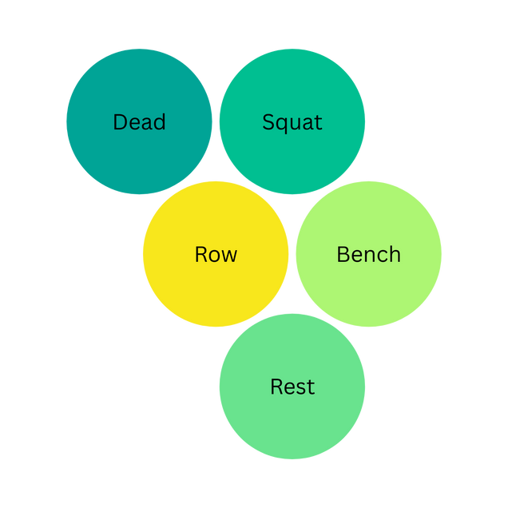
Cluster Analysis
Cluster Algorithm applied on the accelerometer axis, gives a clear explanation of 5 groups discussed in the project before inclusive of labels

Slide 21
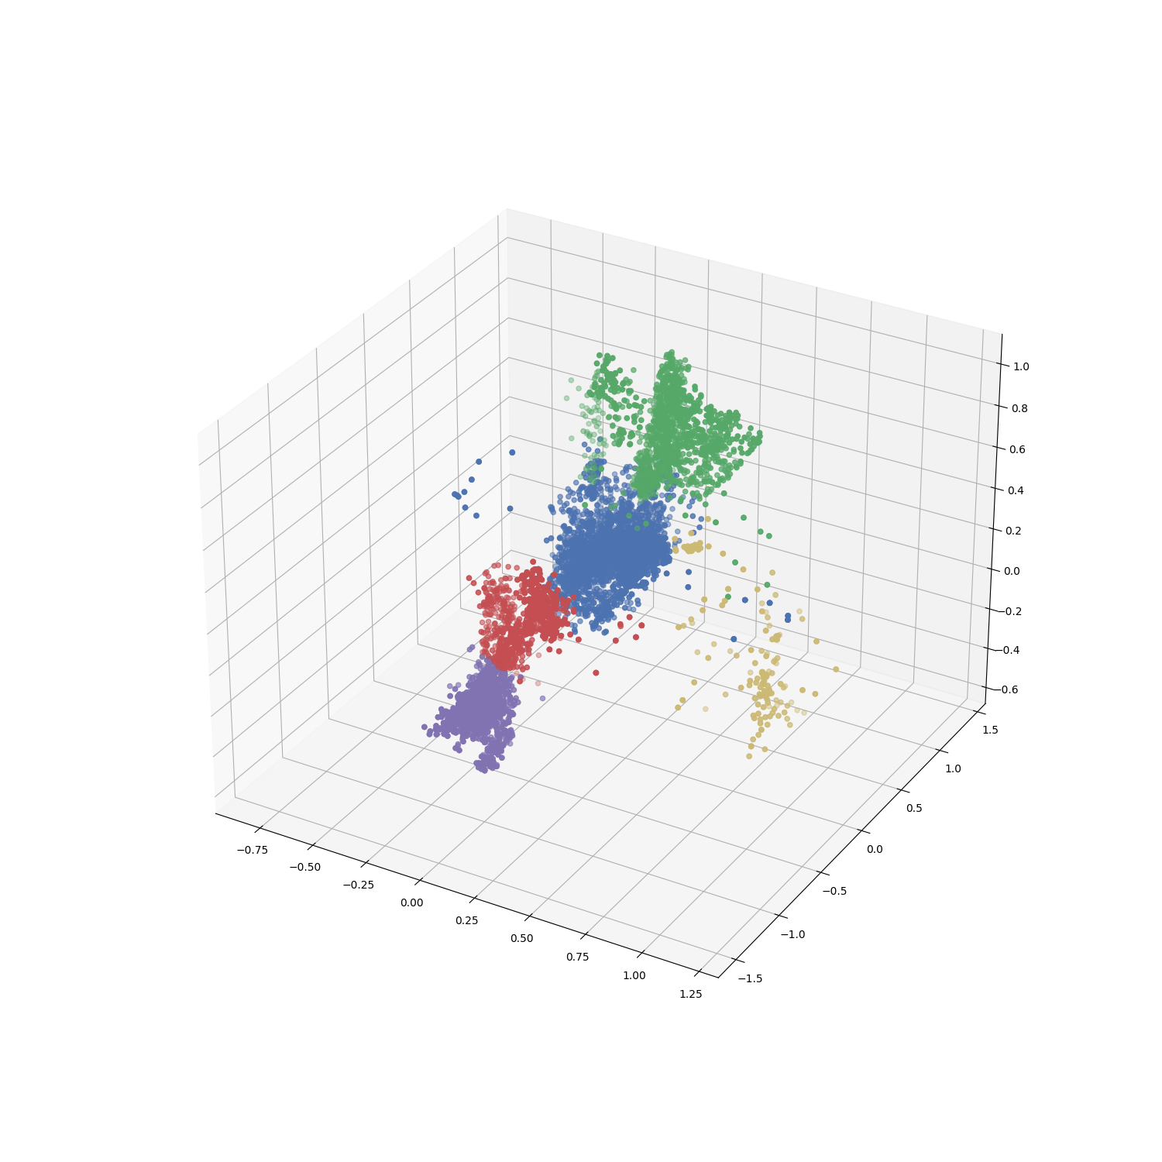


Slide 22
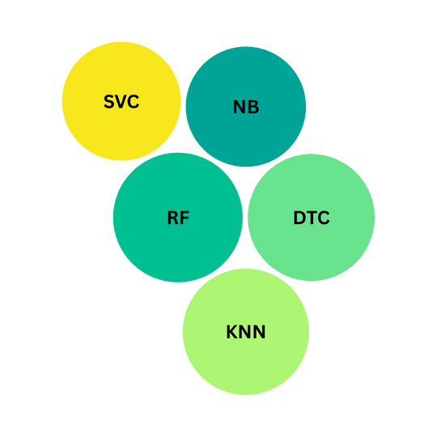
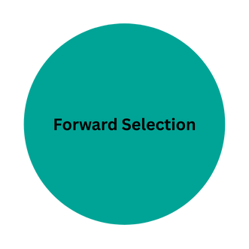
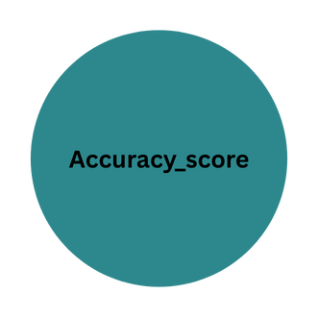

Modelling
Ft. Selection
Metric
Hyper Par

Slide 23
Model Testing
Feature set 1 :
Basic
Feature set 2 : Basic+Squared_features
Feature set 3:
Feature set 2 + PCA + Cluster
Feature 3 | RF | 0.9683
Feature 2 | RF | 0.9678
Feature 1 | RF | 0.9600
Feature 3 | DT | 0.9500
Feature 3 | KNN | 0.8749
Feature 1 | NB | 0.8601

Slide 24
Validation Check
Predicted | Predicted | Predicted | Predicted | Predicted | Predicted | Predicted
Actual | 277 | 0 | 83 | 0 | 0 | 0
Actual | 0 | 531 | 0 | 0 | 1 | 0
Actual | 2 | 0 | 643 | 0 | 0 | 0
Actual | 0 | 0 | 0 | 738 | 0 | 0
Actual | 0 | 3 | 0 | 0 | 84 | 0
Actual | 0 | 0 | 0 | 2 | 0 | 624
Training of 4 Participants and Evaluating on 5th Participant
with accuracy score of 0.9695

